Slide 1
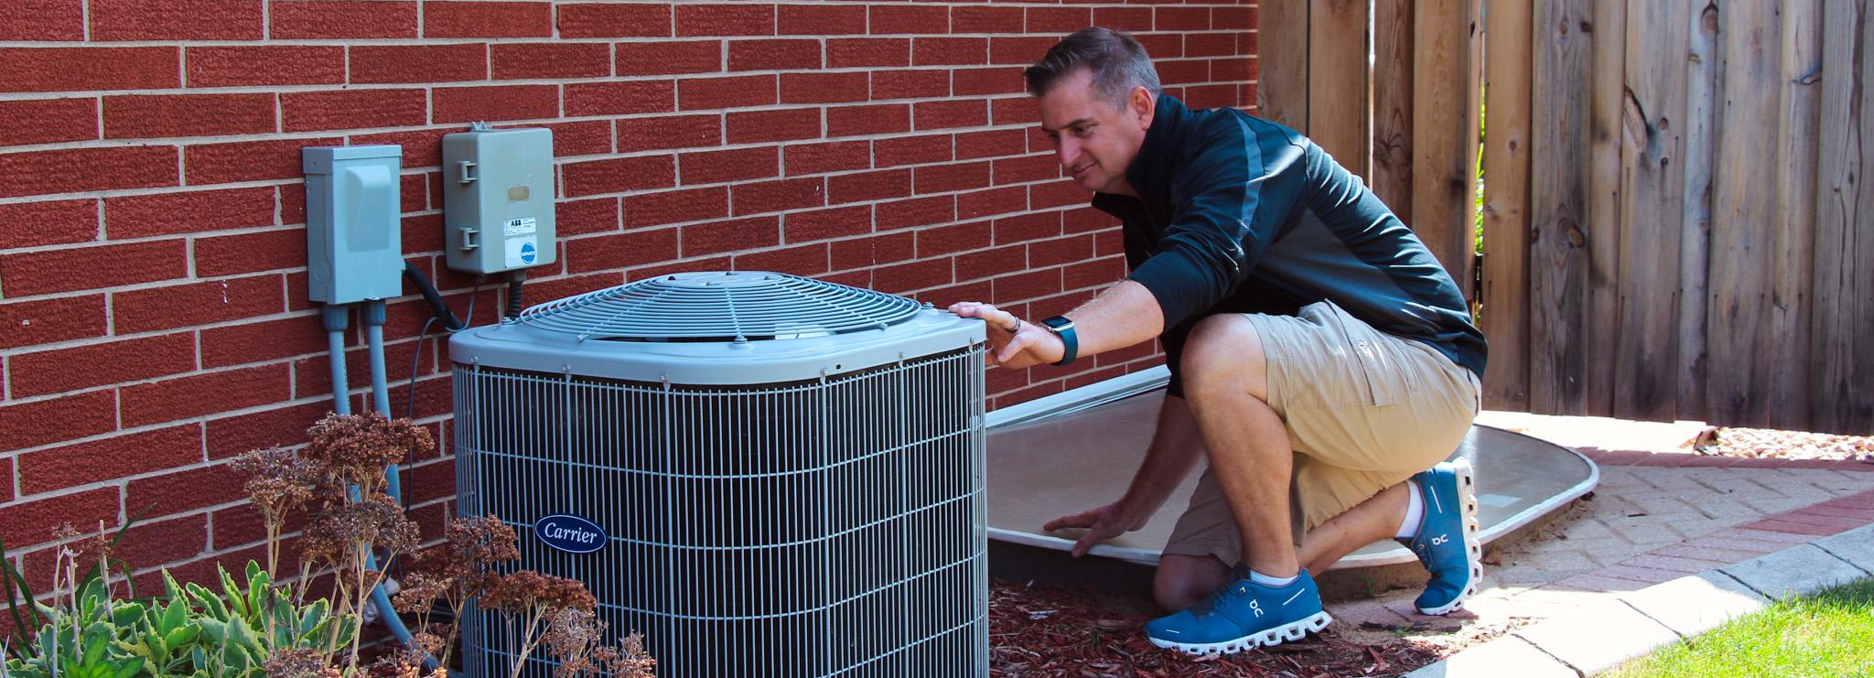
Inspection Certification Associates (ICA) An ICD Educational Partner

Slide 2
Agenda
Who we are and What we Do
Benefits of our Training for Members
How our Training is Delivered
Custom Training Options and Pricing
Questions?

Slide 3
Who we are and What we Do
Inspection Certification Associates (ICA) provides home inspection pre-licensing and continuing education for students, professionals, and companies, empowering individuals from all educational and socioeconomic backgrounds to become professional home inspectors. Participants receive a discount off the standard retail price, in approving states.

Slide 4
Benefits for Members
New Skill and Certification Benefits
New Skill/Certification
Know what to look for when buying a home
Know what to fix when selling a home
Help friends and family make good decisions
Know what to fix and when to fix it in your own home
Supplemental Income
Income of a Home Inspector
Most Home Inspectors will use this profession to supplement their income doing it part time.
Each Home Inspection pays on average $400
Home Inspections take 2 to 3 hours on average.
Many Inspectors develop this skill going into retirement, to create new income.

Slide 5
Training Delivery
How is Training Delivered? (This will depend on the State)
Online
Entirely Self Paced (24/7 Access Never Expires)
Live
Held at a physical location where Classroom or Field Training is performed to meet state requirements.
Virtual Live (Webinar)
In certain states we can perform classroom training via a Webinar format.
Hybrid
In some states Online and Live/Virtual training is required.
State Requirements
Each state is different in terms of what they require for Home Inspection Education
ICA is approved in 49 of 50 states and has the ability to customize training options in order to fulfill state education requirements.

Slide 6
Custom Training Options
Custom Live Training Options
ICD Members attending our live classes scheduled for retail customers
Private Live Classes at your plant
Schedule customized to accommodate all members and shifts
Live training classes in states where it is not required
Flexible Pricing Options
If ICA retail pricing is too high call us!
Each state is different in terms of their required education.
We will work with every plant to identify a plan to make our course available for ICD members that fits their schedule and education benefits.

Slide 7
Thank You!
jim@icaschool.com
Business Development
Matthewb@edcet.com
Director ICA

