Slide 1
Union College Benefit
powered by
Making College Possible
for more workers and their families
Notes:
INTRO
Alecia, Senior Channel Manager –
this is my second time presenting in this role so thank you all for the patience and grace.
3 months @ Edvance.
I am probably one of the newest faces in the room this year, but I am not new to education. If you all will allow me a moment to share.
Worked at an 85 year old private university in Indiana – that myself, my parents and my grandmother attended - guiding the next generation to discern seriously where to go to college.
In time, coaching young people into federal student loans with uncertain job outcomes was not sitting well with my spirit. So I did something about it.
I left! To work at an immigrant founded coding school in Indianapolis that was not even 1 year old when I joined.
This innovative, accelerated education - less than the cost of a single year at my previous university – with promising job outcomes and higher pay in tech - this all felt correct.
Now, understanding the inner workings of traditional and innovative higher ed options - emboldened by a decade in education - I am unyieldingly insistent that money needs to stay in the pockets of working people – whatever school pathway they take.
Obviously I am energized by this work advocating for your members – it aligns with and ignites my spirit.
Starting with a data point to center our conversation about why this is important.
According to the Education Data Initiative in March 2025, the average federal student loan debt balance is $38,000
I don't love hearing that. It also doesn't resonate with my spirit. So – again - I'm going to do something about it. Me being here is doing something about it.
Maybe we can't cut out of pocket cost and student debt for all people, but we can be part of the solution for OUR people - in unions.
Because we look out for each other.
In such a short and impactful 3 months, I already know that unions show up different. Our team will continue to show up with solutions.
So today we are going up and out.
We are raising awareness of this benefit UP and how to share it OUT with your members.
Cut notes:The Union College Benefit powered by Edvance makes college
AND less of a debt ridden life post college possible for workers and their families.
That doesn't have to be the number that members and their families are left with.

Slide 2
Our Model
Our Mission
We are a specialized member-benefit company focused exclusively on higher education.
We create and inspire access to life-changing education and career pathways for members and their families.
edvance.online
EDVANCE | 2025
Notes:
HIGHLIGHTS
For those just learning about us, Edvance is NOT a school.
We are a specialized member-benefit company
focused on higher education
in partnership with Union Plus.
We advocate for members throughout the college decision process
AND
negotiate exclusive tuition discounts of up to 50% off
with our academic partners in our Education Marketplace.
This creates access to life-changing education and career pathways for
active members, retirees and their families .
Who qualifies as family?
Financial dependents including
spouses,
children,
grandchildren,
Those pesky 26 year old squatters in parents basements.
Benefits like this are especially helpful to leverage in right to work states as active members qualify. We love a winning argument for organizing.

Slide 3
“This wasn’t just about getting a degree. It was about finally doing something for myself. And I’m so grateful to my union for making that possible. “
Alison Colello, IUPAT Shop Steward
William Woods University, Spring ‘25 Graduate
Notes:
TESTIMONIAL
We had the opportunity recently to speak to one of our graduates, an IUPAT Shop Steward's testimonial on the screen.
For those in the back, Alison Colello shares,
"This wasn't about getting a degree. It was about finally doing something for myself.
And I'm so grateful to my union for making that possible."
Alison now fosters a culture of learning in her home with her kids and is moving onto her Bachelors after completing her Associates in Leadership.
Did anyone in the room complete a certificate or a degree in the last year?
Can we get some snaps going for Allison and all our sisters and brothers?
Alison is one of the 50 people graduating from one of our partner colleges this spring.
Every single one of those people have new potential on the horizon, career pathways opened up.
Of all the days that you all hear the concerns, fight the uphill battles, this is a shoutout to your collective work and the good it brings.
Notes taken out: This is our work, our mission actualized in real time. While this isn't an everyday benefit, it allows for a major life shift.

Slide 4
Advocating for Members, Strengthening Unions
Affordable Education through the Union Plus Union College Benefit powered by Edvance
Your Members:
Support for Leaders:
Exclusive tuition discounts up to 50% for members AND their families
Flexible, 100% online certificate, undergraduate, and graduate programs
Regionally accredited, transfer-friendly schools with career-aligned offerings
Personalized school matching and dedicated enrollment support
Specialized member-benefit to enhance recruitment and retention
Resources to help maximize awareness and support of the college program
Additional no-cost, co-branded marketing materials to share this benefit with members
Notes:
INTRODUCE North Star and LEADER SUPPORT
Advocating for your members in their college search process on a daily basis is our North Star,
and supporting leaders is a huge part of that work as the people most connected to the membership.
Our no-cost marketing services provide leaders like you
with strategic planning, creative assets like customized flyers or social media content,
reporting and analysis, co-branded web pages, and surveys.
We have the human capital and expertise
to ensure every worksite and local leader that wants individualized support or resources for their workplace
can access it at anytime. More on that later.
Notes taken out:
While members explore our education marketplace with all regionally accredited schools,
we are equipped with coordinated student communications and support to ensure seamless experience.

Slide 5
Education Marketplace
A Stronger, Smarter Path to Education for Union Families
Regionally Accredited
Transfer-Friendly
Tuition Discounts up to 50% Off
Over 125+ Programs Offering
In-Demand Skills & Credentials
100% Online Program Portfolio
Multiple Class Starts per Year
EDVANCE | 2025
Notes:
MARKETPLACE HIGHLIGHTS
With this benefit, your members get access to our education marketplace.
We currently work with 6 schools.
All offer 100% online programs focused on non-traditional student experiences.
With options for Associate, Bachelor’s, and newly added Graduate degrees, and certificate programs
With multiple class starts per year, this portfolio of programs is exactly tailored to fit into the busy schedules of working adults.
There is no need to wait for the typical fall or spring semesters to jump in.
In state vs out of state tuition is not a factor here.
That was part of our requirements for any school we work with. We want your money to go further no matter where your union and loved ones are located.
Notes taken out.
For those of you looking at this list, the question may have come up about the difference for in state vs out of state costs.
That is not a factor here. The tuition discount applies across these schools regardless of state lines because in part of our advocacy for your members and their families.

Slide 6
Education Marketplace Programs
Over 125 Program Offerings from Partner Schools
POPULAR PROGRAMS
NEWLY AVAILABLE PROGRAMS
Business
Accounting & Finance
Criminal Justice
General Studies
Health & Human Services
Medical Assisting & Coding
Healthcare Administration
Legal Studies
Associate Degrees
Business
Management & Leadership
Cybersecurity
Psychology
Project Management
Business Analytics
Information Systems
Health Information Management
Bachelor’s Degrees
MBA (also offered fully in Spanish)
Master of Education
MA in Org Leadership
MS in Management
MS in Criminal Justice
MS in Artificial Intelligence
MS in Engineering Management
Doctorate in Quality Systems
Graduate Degrees
Information Systems
Healthcare Administration
Business Technology
Organizational Leadership
Environmental Health & Safety
Supervisory Management
Quality Technology- Lean Six Sigma
Education
Certificates
Notes:
PROGRAM FOCUS
Here's a sample of the 125 program offerings where the average cost per credit hour is $223
There will be a QR code at the end of the presentation for you to toggle through programs and see for yourself.
Popular:
Certificate in Organizational Leadership
Bachelors in Cybersecurity
MBA offered fully in Spanish
New:
Associates in Healthcare Administration
Bachelors in Project Management
Masters in Artificial Intelligence
We are always hungry for feedback!
If there are programs your members are interested in that are not currently listed, we want to hear from you!
It's important to us that we are serving your membership with relevant programs for them.
Maybe on top of the discount, more scholarships and grants are available.
FAFSA is not required to access the benefit but can be used if desired.
Apply any additional funding sources like the Union Plus Scholarship to further reduce out-of-pocket costs.
So we provide the discounted rates for the individual,
how they pay for the remaining balance of tuition is between the individual and the school.
An OEA Local President shared with us that she has two kids in college:
her daughter that went the more traditional route and her son attending remote school through this benefit.
His annual tuition cost is less than half of his sister's.
Significantly reducing the out of pocket cost year over year.

Slide 7
Union Member Experience
Guided Experience
Members and families can inquire at no-cost to get their best-fit school match based on their goals, educational background, and desired start— Edvance then helps them explore options or take the next step to enroll with confidence.
Co-Branded Landing Page
School & Program Match
Unique School Application
Explore the Marketplace
Notes:
MEMBER EXPERIENCE IN THE MARKETPLACE
Now let's take a stroll through what someone would experience if exploring this benefit.
Members or their families complete a three-step form where they fill out very basic information on their education preferences.
Our matching feature then provides a program recommendation based on what was submitted
Then this Thank You page highlights the program, what you will learn, credit hour cost, the next start date and transfer credit info.
Folks can click to apply to the school directly
OR
Explore the greater marketplace of 125 programs.
There’s no cost to inquire and no application fees.
No cost will be incurred by a student until they official register with the school.
How do we know that if someone who applies is an active union member, retired, or a family member?
Eligibility is verified through Union Plus, including checks for union membership status and standing.
Notes taken out: This is a long decision process with serious reflection required for adults going back to school let alone young people investing in college.

Slide 8
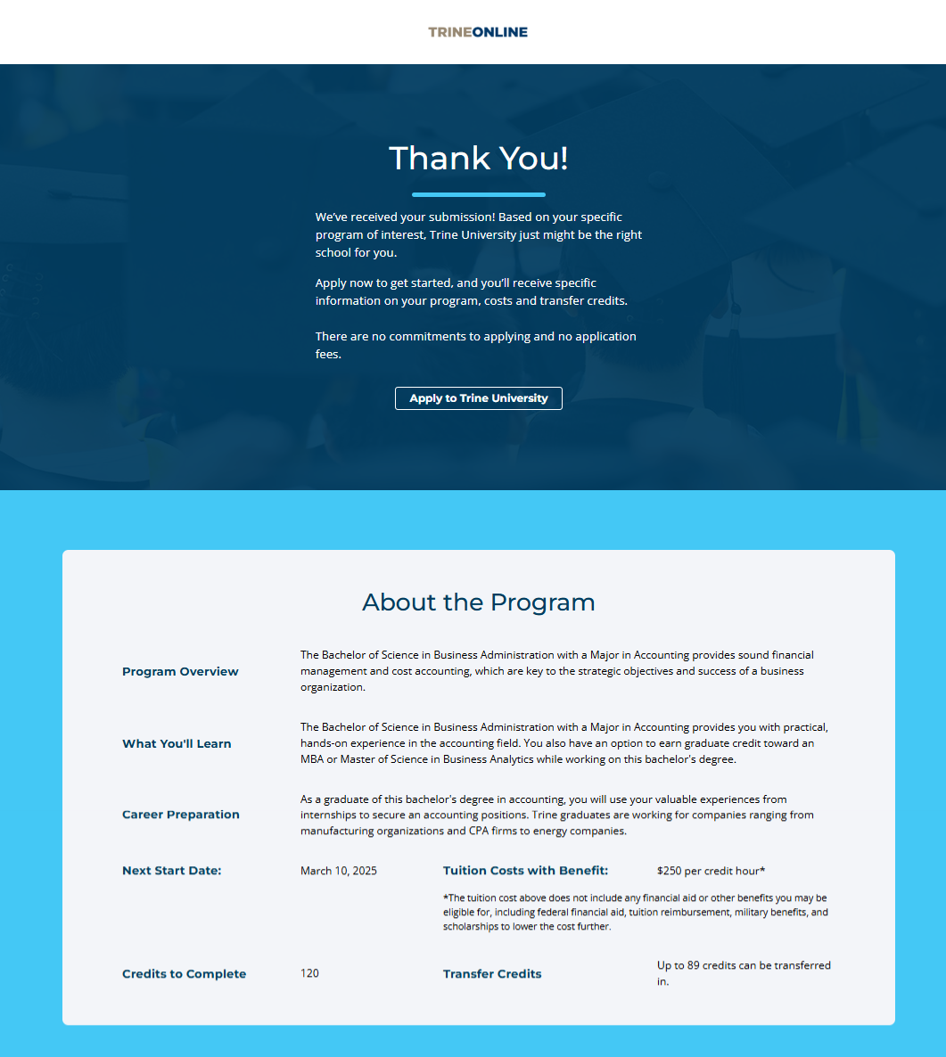
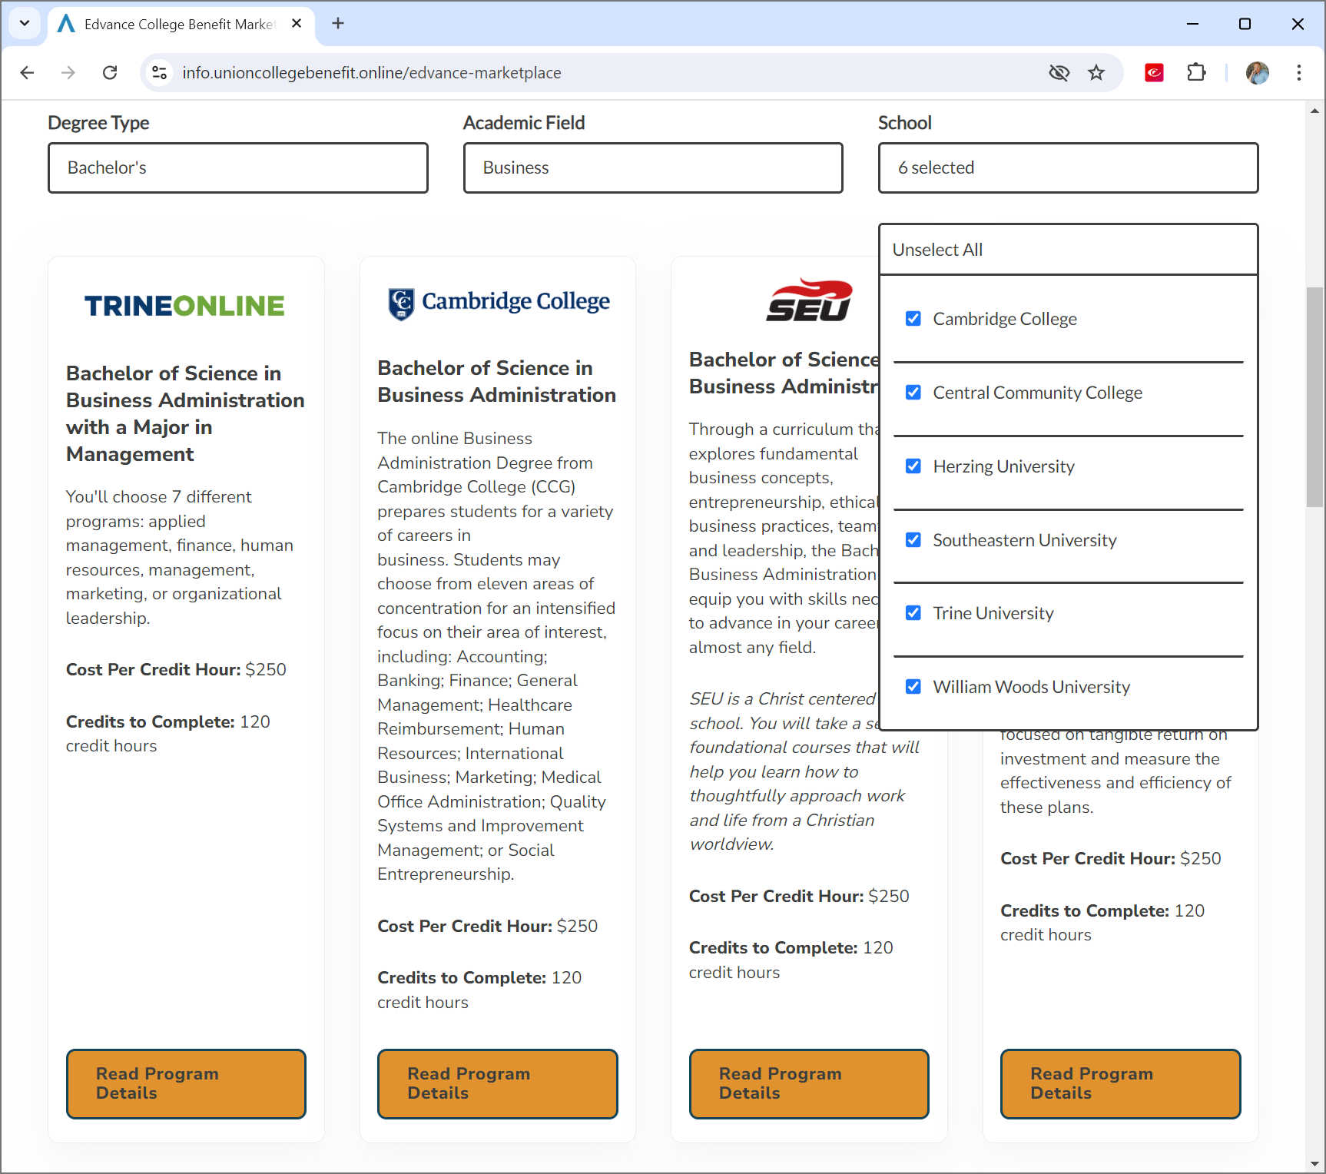
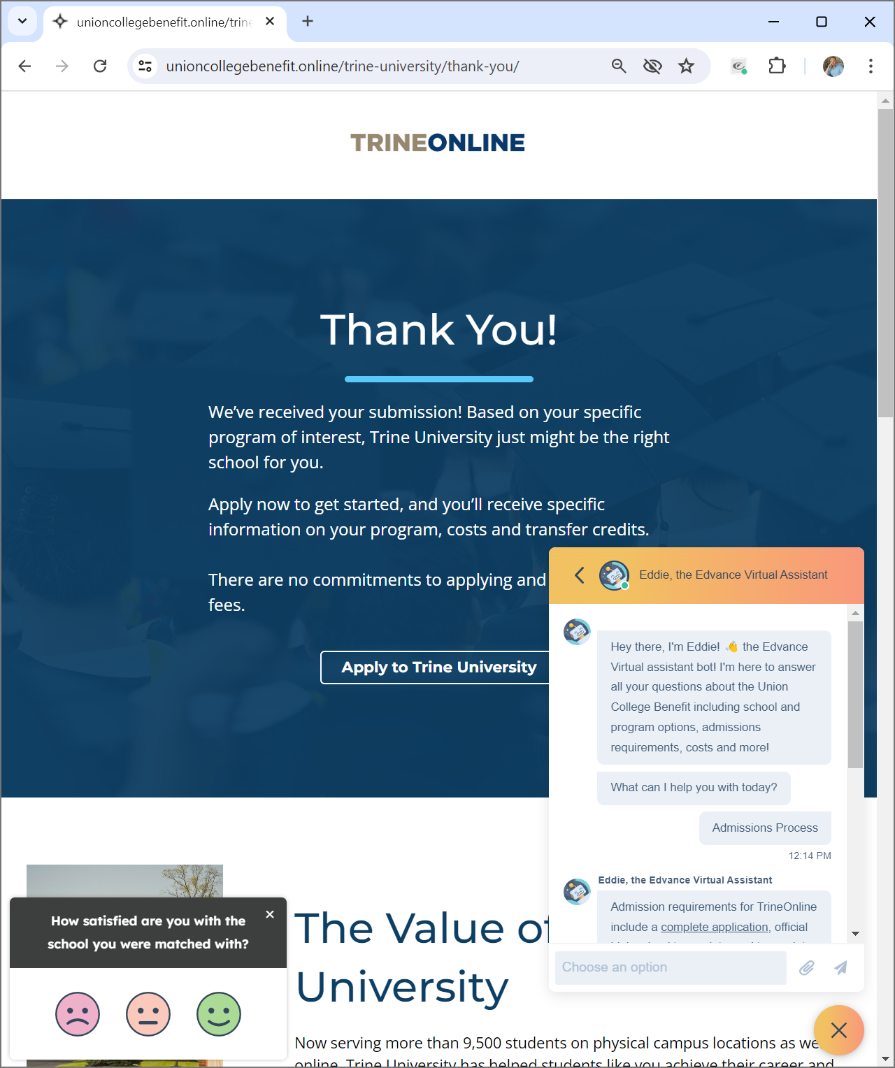
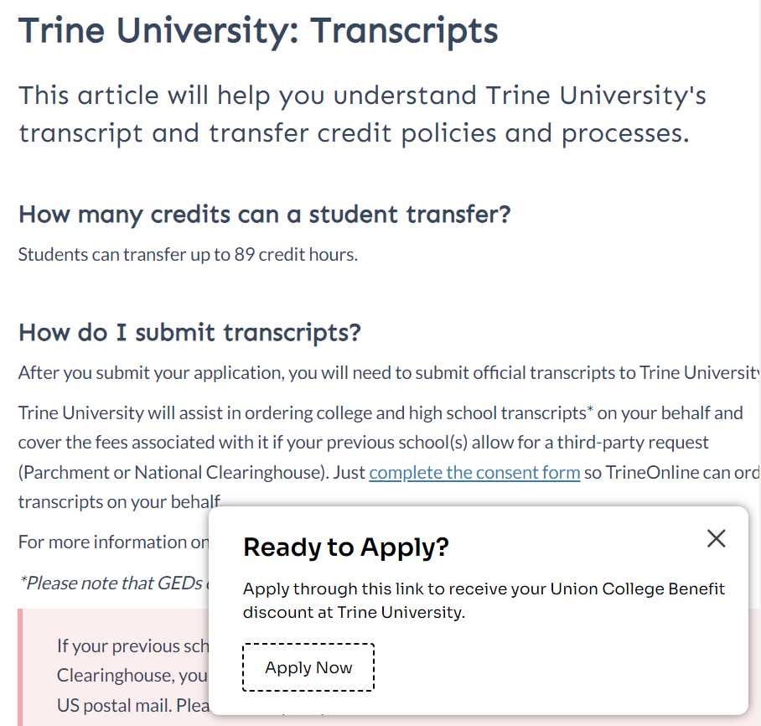
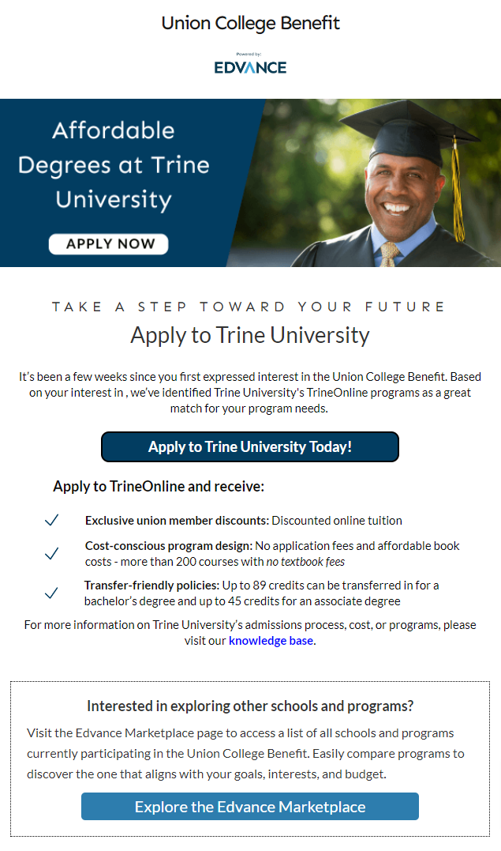
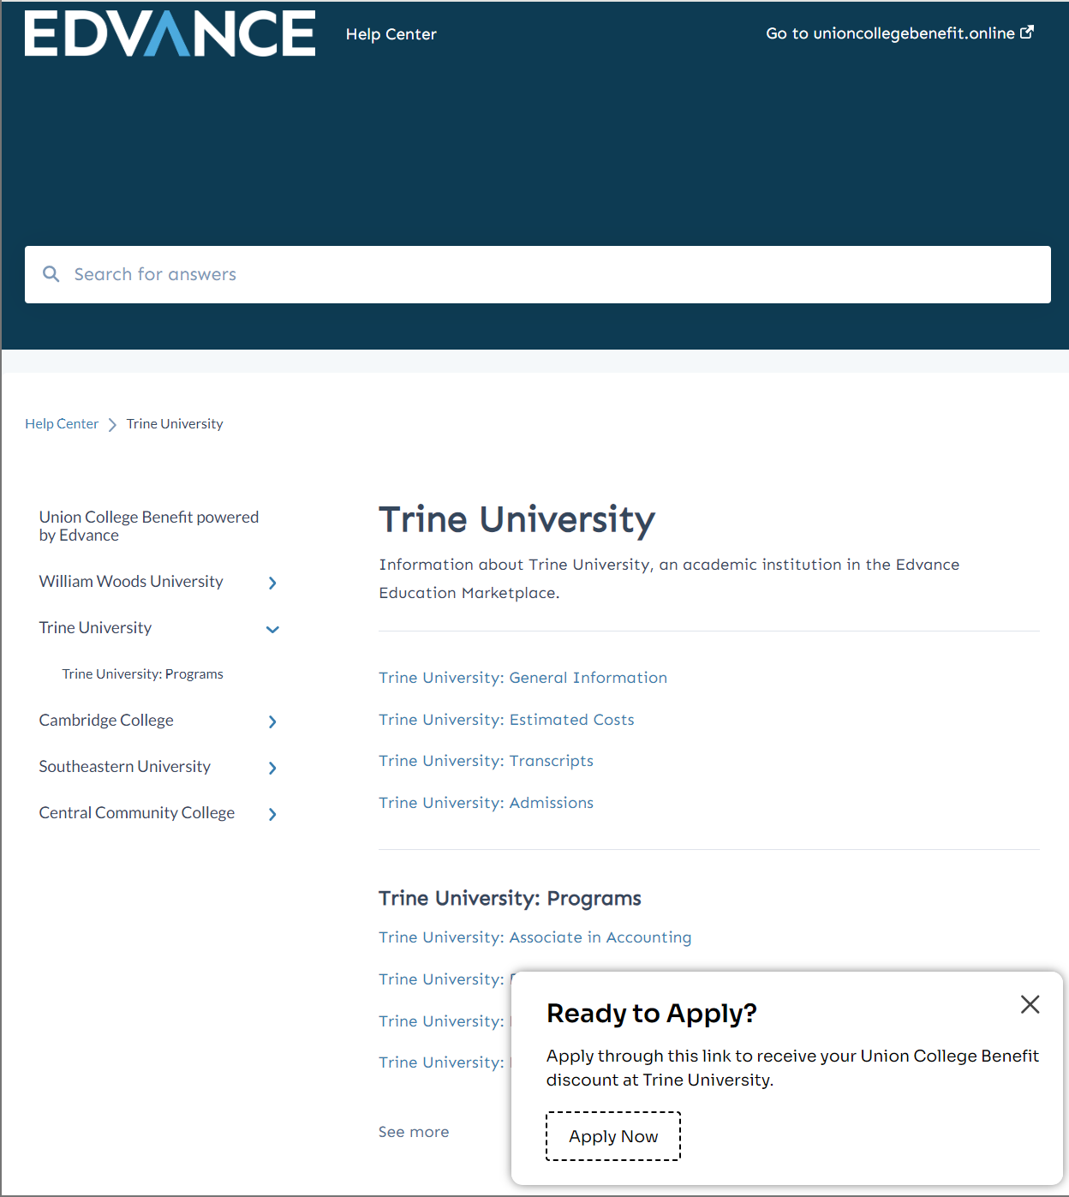
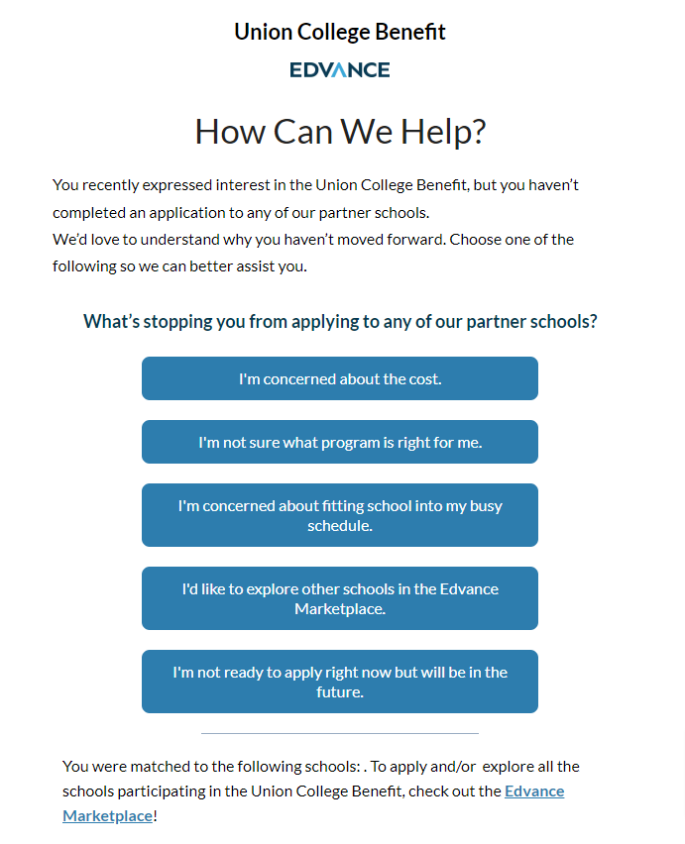
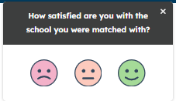
Edvance Marketplace Assets
School Match Page
Marketplace Page
Knowledge Base
Users complete simple, 3-step form for school match
Edvance provides recommend School Match
Users can apply or explore more options in the full Edvance Marketplace
Users can explore all programs and schools on the Marketplace Page
Sort by degree type, academic field, and schools to show a comparison of outcomes and cost
Searchable Knowledge Base has FAQs about Edvance schools, programs, transcripts, and admission policies.
Includes helpful articles related to FAQ like affordability and work-life balance
Email
Call
Surveys
Text
Chatbot
Follow Up Matrices
Edvance surveys users at key points to assess satisfaction with their match
Insights enable personalized follow-up messaging
Chatbot provides 24/7/365 asynchronous prospect engagement
Supports new and returning visitors with timely guidance at every step
90-day communication across multiple platforms like email, text, and phone
Follow up and support to assist in decision-making process
Chat
Notes:
MARKETPLACE & MEMBER EXPERIENCE Con't
Going to the next slide – we just talked about the Thank You page.
This is a larger view of our marketplace which allows someone to sort for according to their preferences.
Our knowledge base pictured here is complete with FAQs about the schools we work with, transcripts and admissions requirements.
We conduct one question surveys to assess satisfaction with matches
Our team is available across all forms of communication including chatbot Eddie available 24/7
After someone inquires, a card carrying OPEIU union member on our team reaches out.
These are our Student Success Counselors who are there for your people assisting in the decision making process.
Having someone in your corner to advocate for you
just as your union advocates for your respective benefits and workplace benefits
– we do this for you with the education benefit.
While we are not the school, we will help provide anyone that comes through our platform the support to get to the right people at the school – through financial aid, registration, to final enrollment.
Whatever channel of communication folks prefer, we offer it!
Even for those that do not want to connect with a human or who just got off 2nd shift later at night.
The important thing is that we are meeting your people where they are.

Slide 9
Organizing Through Opportunity
Working Together to Advance Missions and Change Lives
Organize
Retain
Serve
Affordable options help support the value and benefit of joining your union:
Maintain a strong, committed membership:
Offering professional development and training opportunities:
Incentivizes workers especially in “right-to-work” states
Extends to Family
Long-term Impact
Support Member’s Needs
Degree & Skill Attainment
Career Progression
I honestly would not have gone for my bachelor's without my dad's union [benefit] to help pay for it. – Jess Phillis, Daughter of USW Member
Notes:
LEADER RESOURCES
Why would someone want to work with us? Why promote this benefit?
Our services cost leaders like you or your union NOTHING. No retainer. No cost for marketing services and return value that we can provide.
Other union leaders have stated to us that even organizers are not aware of these benefits.
Yet it's a critical organizing and retention tool.
This is how Edvance Supports Union Growth
With Organizing: Offering valuable education benefits can be a powerful incentive for workers to join your union especially in right-to-work states.
Retain those members: Members are more likely to stay when they see ongoing value in their membership. School isn't short, so this has a long-term impact where your members develop themselves and pay dues over time.
Also no one would want a tuition bill that is thousands more dollars than expected because they are no longer active members. They'll probably want to start paying their dues again.
Finally, Engagement: Education benefits can increase member participation and loyalty to the union.
Notes taken away:
Edvance offers ready-to-deploy resources: marketing toolkits, co-branded web pages, inquiry tracking, and communications support.
As well as regular reporting on member engagement, interest areas, and outcomes.
This benefit can strengthen your organization with a premier education benefit that helps your union organize members, retains current ones, and serves your members– all at no cost to you.
The benefit pays for itself in the long run.
We leverage our level of marketing and data sophistication for you.

Slide 10
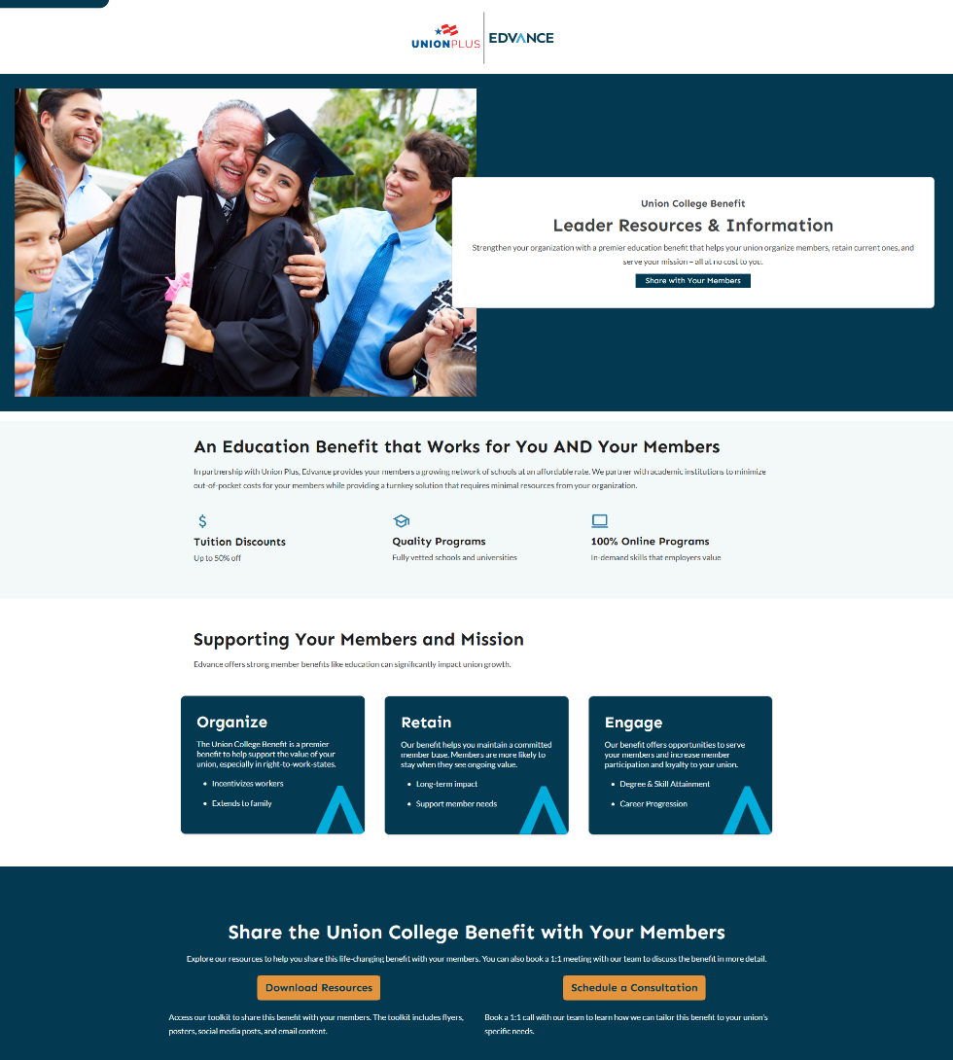
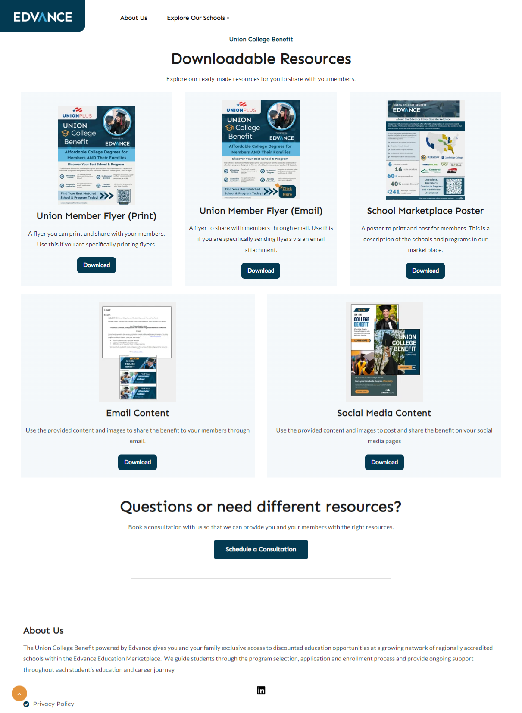
Union Leader Resources
Share the Benefit
Increase awareness and maximize participation of the college programs at the leader-level to help with organizing and retainment.
Leader Resource Page
Leader Toolkit
Notes:
LEADER RESOURCES: ACTIONS TO TAKE
We have raised awareness UP about this benefit, now it's time to take it OUT to your members!
Scan the QR code on the screen for access to your specialized leader resources.
The image on the right is the screen you will be taken to.
Scroll down, Click Download resources in the yellow box to access
flyers for print or email
social media posts,
and other content.
Anytime day or night we will meet you where you are at – local events, new employee orientations, webinars, virtual sessions.
Consider Edvance your in house marketing team for the Union College Benefit!
I am here to help your unions generate awareness at the local and worksite level.
If this is making lightbulbs go off, you have specific questions,
I have my calendar we can schedule time further out easily.
We’re here to support your union.
Notes taken out: For busy leaders, we have tailored tools to reach your members across every channel.
The more we collaborate, we get to know your union and your organization, so that we understand how to speak to your members – including tailored marketing materials with images that reflect your membership.
we have the human capital and are happy to collaborate on opportunities.

Slide 11
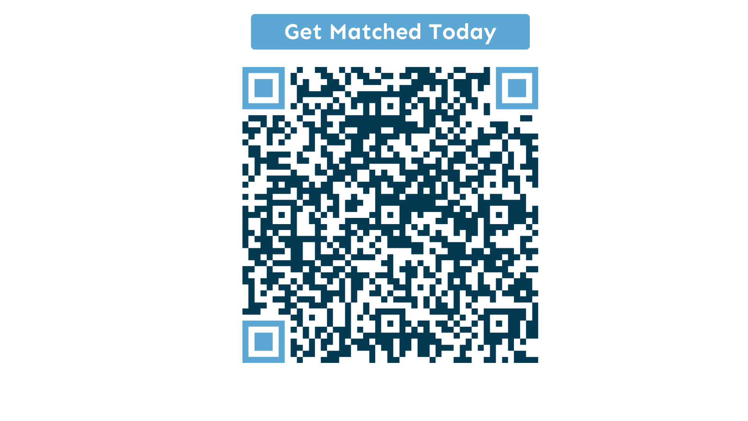
Alecia Kissel
Senior Channel Manager
akissel@edvance.online | 404-507-6626
Notes:
Really appreciate everyone's time and attention as well as the opportunity to share today – thank you UFCW team.
To be extra clear -
The QR code on the previous slide is for YOU as leaders to share info easily out to your members.
The Education Marketplace QR code on the screen NOW is for your members.
Scan it to check out our Education Marketplace and see for yourself.
I have informational flyers for both leaders and members if you want to take any back to your worksite.
There is additional college and program specific information on a few slides after this
which we can share this slide deck with Seth and team to send out to you all.
Questions?
Potential Review questions at the end of the deck:
How many colleges and universities are in the Union College Benefit Marketplace? 6
How many people have decided to enroll through the Marketplace? 900
What is the range of cost per credit hour
What’s in it for the schools? Yes, they want to support unions but union members and their families are vast as an audience. It’s an audience they may have been luck and visibility with by going through us.
Is payment required before the start? When is it due? That is school dependent but most often after after the first week of school.
Does the system recommend the most cost effective option first? Request for AK – can you remind me of how to reply? Cannot recall the response, but it may went the long way around to answer when this is something we would want to answer as directly as possible.
At what point are you out of the picture and the school takes over?
What are the criteria do you have to bring schools on?
Can we share the standing starts of our programs?
When is the soonest someone would start looking at school? User preference. Marketplace is open at all times.
Do we provide different avenues for scholarships? Edvance currently contributes to the UP scholarship fund

Slide 12
Education Marketplace Academic Partners
 | WWU | HERZING | TRINE | CAMBRIDGE | SOUTHEASTERN | CENTRAL CC
Accreditation | HLC | HLC | HLC | NECHE | SACSCOC | HLC
Public/Private | Private/Nonprofit | Private/Nonprofit | Private/Nonprofit | Private/Nonprofit | Private/Nonprofit | Public
2 Year / 4 Year | 4-Year | 4-Year | 4-Year | 4-Year | 4-Year | 2-Year
Location | MO | AL, FL, GA, LA, MO, OH, TN, WI | IN, MI, AZ | MA, CA, PR | FL | NE
Programs Offered | AA, BA, Certs, Masters, PhD | AA, BA, Certs, Masters | AA, BA, Certs, Masters | AA, BA, Certs, Masters | AA, BA, Certs | AA, Certs, Diploma
CONFIDENTIAL | EDVANCE | 2025

Slide 13
Education Marketplace Programs
Over 125 Program Offerings from Partner Schools
Associate Degrees
Bachelor’s Degrees
Certificates
Accounting
Art
Business
Communications
Criminal Justice
Cybersecurity
Diversity
Education
English
General Studies
Human Resources
Industrial Engineering Technology
Information Systems
Leadership
Legal Studies
Liberal Arts
Psychology
Social Sciences
Accounting
Applied Management
American Sign Language
Business Administration
Criminal Justice
Cybersecurity
Communications
Digital Media & Design
Extended Reality
Finance
Global Education
General Studies
Management
Human Resources
Human Services
Information Systems
Marketing
Organizational Leadership
Legal Studies
Psychology
RN to BSN
Tourism & Hospitality
Accounting
Administrative Professional
Digital Marketing
Diversity, Equity, Inclusion, & Belonging
Healthcare Administration
Healthcare Billing & Coding
Information Systems
Marketing
Organizational Leadership
*For a comprehensive list of program options, visit our site and fill out our form.

Slide 14
Education Marketplace Programs
Over 125 Program Offerings from Partner Schools
Graduate Degrees
Business & Management
Master of Business Administration (MBA)
Master of Science in Accounting (MACC)
Master of Science in Business Analytics (MSBA)
Master of Science in Management (MSM)
Master of Arts in Organizational Leadership (MAOL)
Doctorate in Quality Systems and Improvement Management (DBA)
Computer Science & Information Technology
Master of Science in Artificial Intelligence
Master of Science in Information Systems
Criminal Justice & Public Safety
Master of Science with a Major in Criminal Justice
Engineering
Master of Science in Engineering Management
Education
Master of Education (MEd) in Curriculum and Instruction
Master of Education (MEd) in Early Childhood Teacher (PreK-2)
Master of Education (MEd) in Teacher of Students and Moderate Disabilities
Doctorate in Leadership and Adult Learning in Organizations (EdD)
Healthcare & Nursing
Master of Science in Nursing (MSN)
Master of Healthcare Administration (MHA)
Master of Science in Healthcare Management
Master of Education (MEd) in School Nurse Education
Psychology & Human Behavior
Master of Arts in Psychology
Master of Education (MEd) in Psychological Studies
*For a comprehensive list of program options, visit our site and fill out our form.

