Slide 1
Educational Investor Services (EIS)

Slide 2
Company History and Mission
Educational Investor Services (EIS) founded in 1995 has been educating USW and UAW members about their 401k plans for 30 years. Some of our customers include ATI, Allison Transmission, BFGoodrich, Bridgestone, Cleveland Cliffs, Contitech, General Motors, Goodyear, Rolls-Royce and US Steel.
Unlike financial advisors, Educational Investor Services does not sell or manage securities. Teaching the members to manage their own investments is our ultimate goal.

Slide 3
401K Investment Classes
Our investment classes are offered in any format or shift time that meets your members’ schedules. All courses are customized around company offered 401k choices
Our classes have been immensely well received. Highest rated class by Saturn Corporation and GM Power Train North Flint

Slide 11
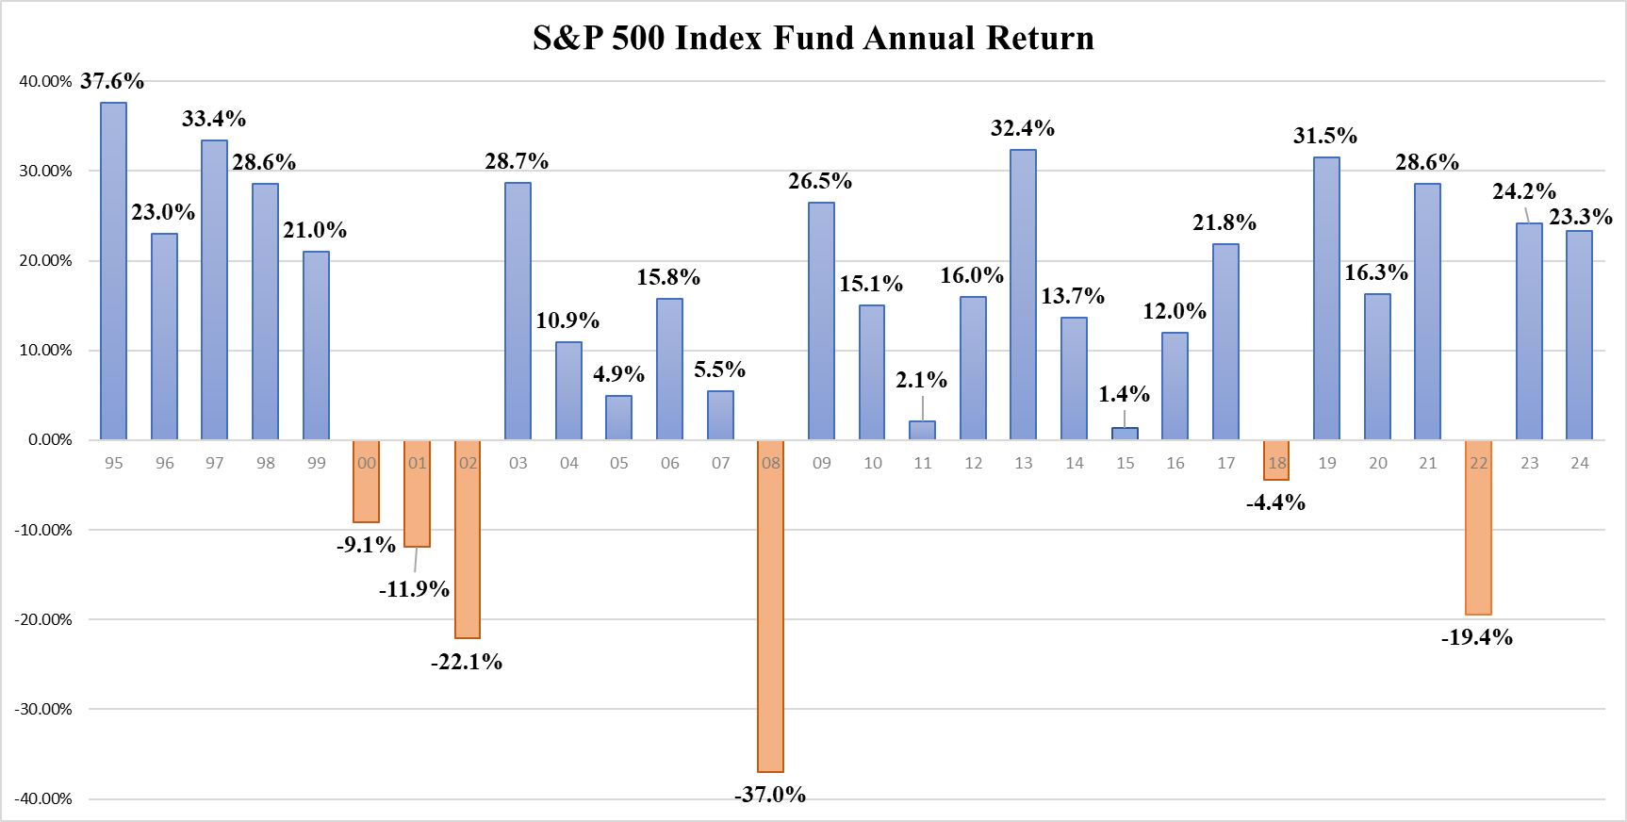

Slide 12
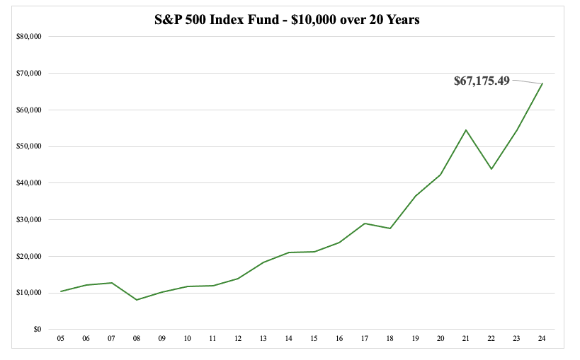
The S&P 500 outperforms 80% of all Mutual Funds

Slide 14
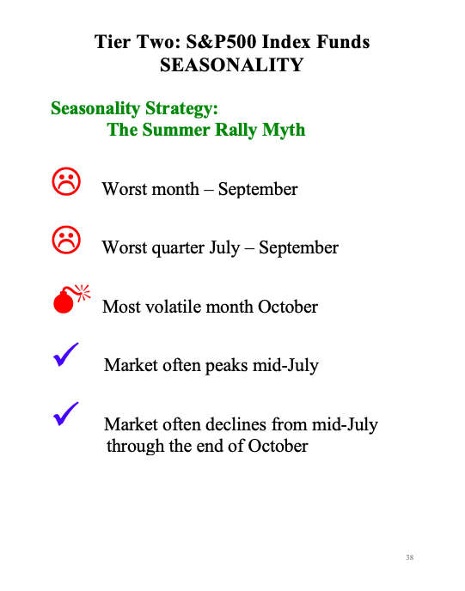

Slide 15
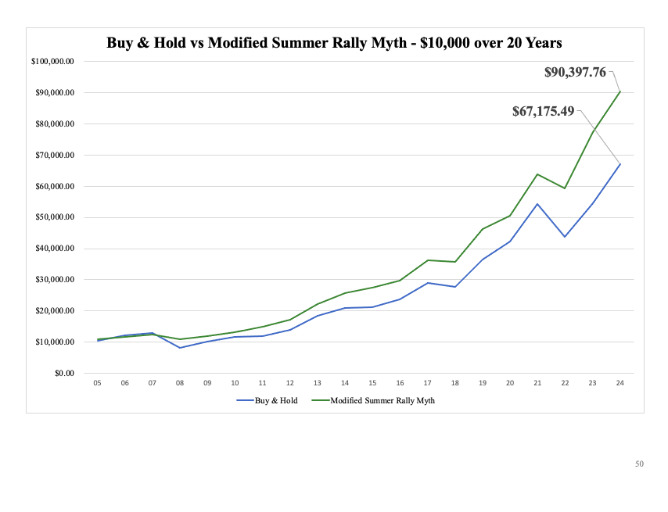

Slide 18
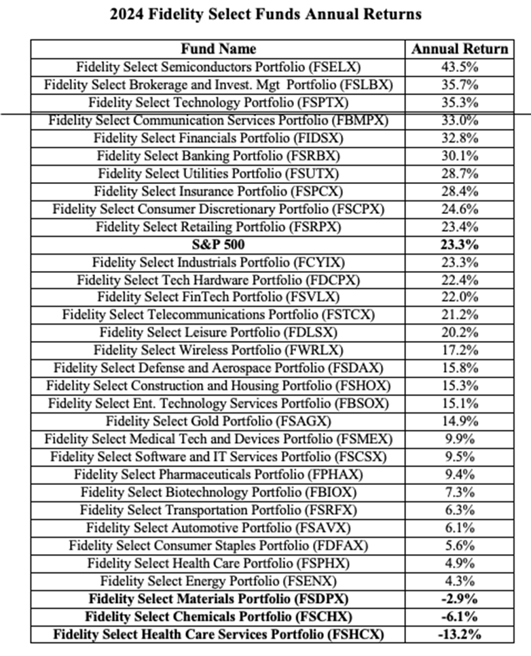

Slide 19
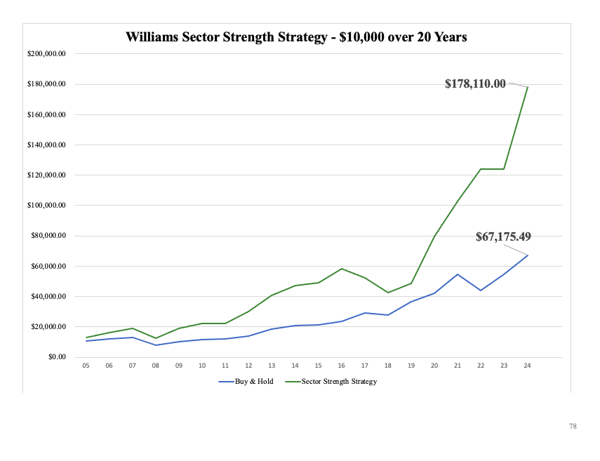
Outperforms all other buy and hold Mutual Funds

Slide 21
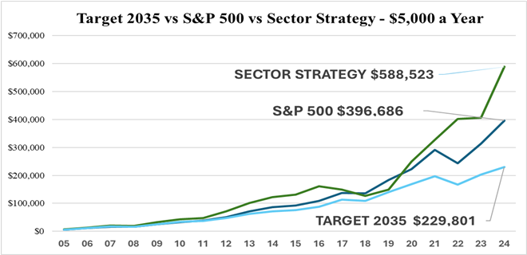
Roth IRA – Withdrawals are Tax Free
Top 401k Mutual Fund in the Roth 401k - Withdrawals are Tax-Free
Default Fund with a 3% Contribution to Pre-Tax 401k: Withdrawals are Taxed

Slide 22
Now what? Classes are being scheduled continually If you feel this information will be of value to your membership Contact us: EIS (850) 502-0909 eis@provide.net

