Slide 1
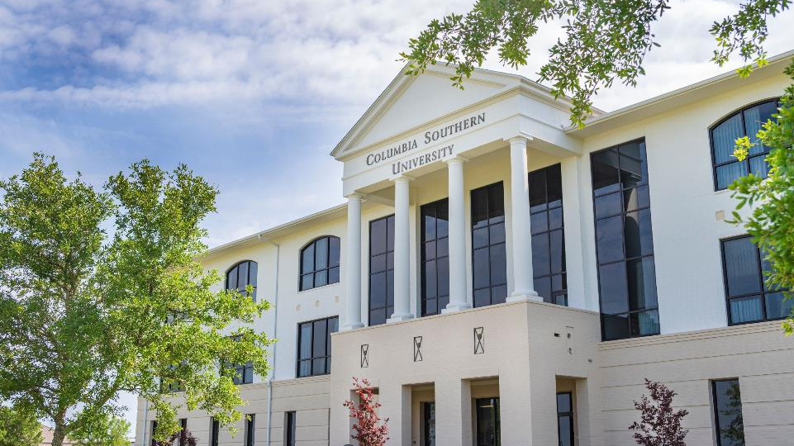
Columbia Southern University 100% Online Offering Associate through Doctoral degrees since 1993

Slide 2
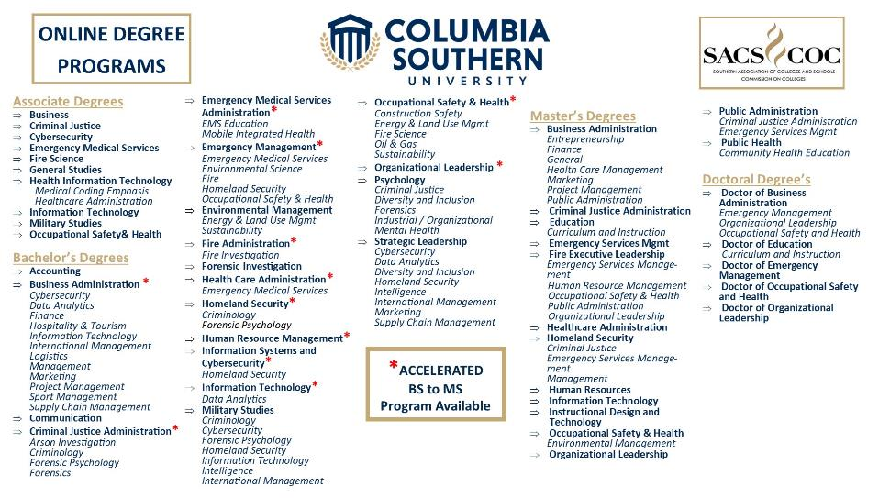

Slide 3
Institutional and Program Accreditations

Slide 4
WHY CSU?
100% ONLINE – (no residency requirement)
9 Week Classes, Available 24/7 Unit 1 MUST be Completed in Week One. Each Class is 8 Units
NO Group Projects
eTextbooks and all Course Materials Included
Flexible Start Dates: 11 Start Dates per Year; You can start on any of those 11 dates!
Transfer Credit Evaluation for Previous College Credits AND for Job/Military Training (Academy Training, OSHA classes, Paramedic, EMT, Professional Certificates, etc,)
Learning Partnership Discounts Available

Slide 5
Benefits of a CSU Learning Partnership
10% Tuition Discount
Discount extends to spouses and children of the employee, organization members and clients.
Exclusive Scholarships
You are eligible to apply for the Learning Partnership Scholarship. (6 awarded /year)! This scholarship is good for up to three years or until completion of the degree program.
Application and Transcript Service at NO cost.
eTextbooks Included in Tuition Cost
Access to our Career Services Department
Ability to advertise open positions, math and writing assistance, career planning webinars, and more.
For Further Assistance or Additional Questions, Contact: Ernie Smith, ernie.smith@columbiasouthern.edu 251-923-4055

Slide 6
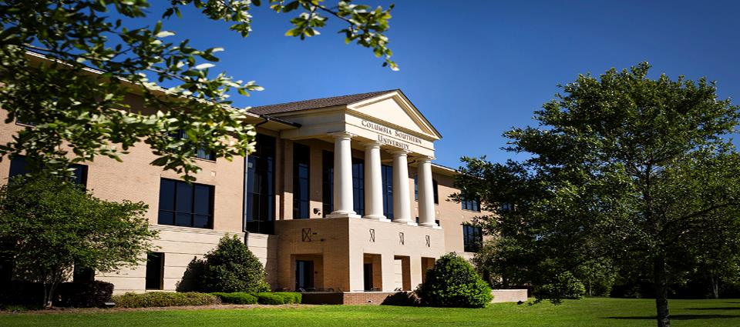
OPEN SCHOLARSHIPS APPLY NOW!
SCHOLARSHIP Awarded
Learning Partner Scholarship 6 per Year May, August, Nov.
CSU Safety Scholarship 2 per Year June, December
CSU Fire Scholarship 2 per Year April, September
CSU CJ Scholarship 2 per Year June, November
Knight Scholarship 4 per Year May, July, Sept, Dec (for a first time CSU student)
Forever a Hero Annually August (must be a USA Military Veteran)
Robert G. Mayes Scholarship Annually October (CSU B.S. Graduate returning for a Master’s Degree)

Slide 7
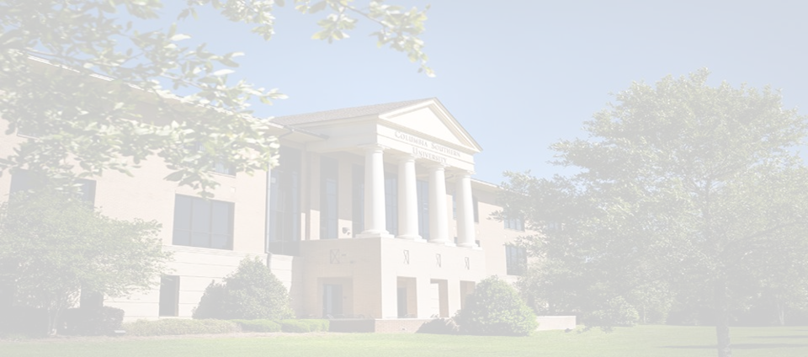
2025-26 TUITION RATES:
$AVE MORE! Full Course
Per Credit Hr. Full Course w/ Discount
Undergraduate $278.00 $869.00 $785.60
Graduate $359.00 $1,122.00 $1,014.30 Doctoral $561.00 $1,743.00 $1,574.70
TRANSFER MORE!
HRS Required Max Transfer HRS Required Max Transfer
Associate 60 45 Master’s 36 24
Bachelor’s 120 90 Doctorate 61 34

Slide 8
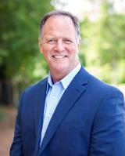
TONY ATCHLEY
Director, Business Development
850-380-3829
Tony.Atchley@ColumbiaSouthern.edu

