Slide 1
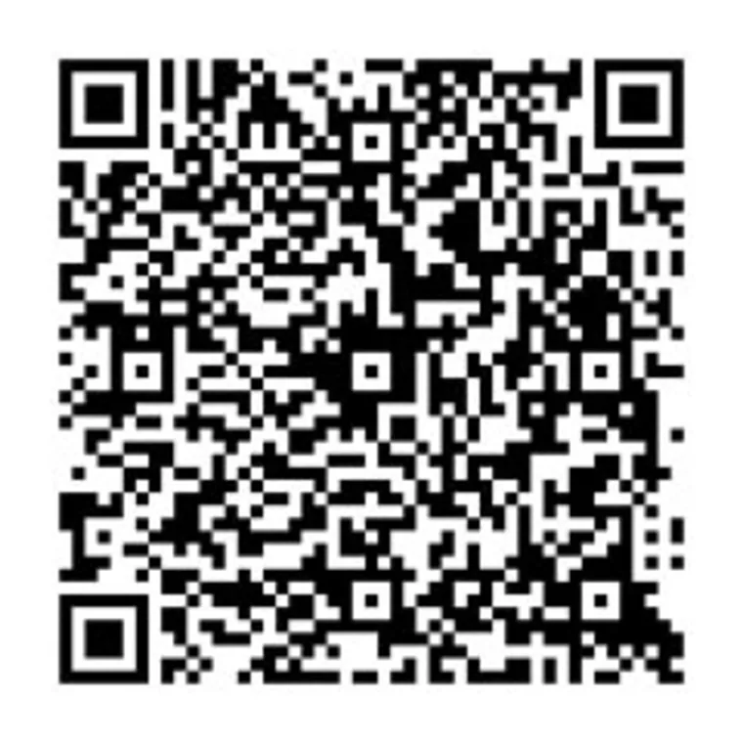
The QR Code and Beyond
ICD 2023 National Conference
Korey Fiste and Jenny VanDyke

Slide 2
What Does “QR Code” Stand for?
Notes:
After consulting a variety of sources, you will need to narrow your topic. For example, the topic of internet safety is huge, but you could narrow that topic to include internet safety in regards to social media apps that teenagers are using heavily. A topic like that is more specific and will be relevant to your peers. Some questions to think about to help you narrow your topic:
What topics of the research interest me the most?
What topics of the research will interest my audience the most?
What topics will the audience find more engaging? Shocking? Inspiring?

Slide 3
Why Host This Session?
Group of coordinators requested the topic
Some ICD Sites are using QR Codes in a variety of ways with benefits
We want to provide some general information and show how easy it is to create a QR Code
It’s a tool that isn’t going away any time soon
Notes:
Now, that you have narrowed your topic, you will want to organize your research in a structure that works. There are some common organizational patterns based on the kind of research you are doing.
Organizational Structures:
Cause and Effect- this kind of structure is great for explaining the causes and effects of a topic
Compare and Contrast- in this pattern you highlight the similarities and differences of the topic
Explain process- this structure is great for outlining a series of steps to follow;
Definition- if you want to make sure your audience understands what something is using illustrations, meanings, clarifying misconceptions, you may want to use this structure
Classification- a common organizational structure is grouping like topics or facts from the research together. For instance, in the internet safety about social media apps, you may organize the research where you look at each social media app one at a time

Slide 4
Getting To Know The QR Code
Matrix barcode or two-dimensional barcode
Invented in 1994 by Masahiro Hara , Japanese company Denso Wave – automotive parts
Design influenced by black and white pieces of Go Board Game
Faster readability and greater storage capacity compared to the standard UPC Code (Denso Wave was using multiple UPC Codes on box parts)
Notes:
After you’ve done your research, it’s time to put your presentation together. The first step in the process is to introduce the topic. This is a great time to connect your topic to something that your audience can relate. In other words, why should they listen to all the information you will be sharing in your research presentation? What is in it for them? You may also want to include a graphic or image to grab their attention.
Feel free to duplicate this slide by right-clicking on this slide in the slides pane to the left and select Duplicate Slide.
The next step in your presentation is to state your claim or topic clearly. Your teacher may even call this your thesis. As you state your thesis, you may find that this layout is not the best layout for your claim or topic. You can change the layout by clicking the drop-down menu next to the Layout in the Slides menu section. You can choose Two Content, Comparison, or Picture with Caption. Note: A different layout might change the look of the icons on this page.
You will also want to state your facts. You have done the research now share some of the interesting facts with your audience. Facts do not have to be boring; you can communicate facts in a variety of ways by going to the Insert Tab. In the Insert tab you can:
Insert pictures from your computer or online.
Add a chart
Create some SmartArt
Insert a variety of icons to help your facts come to life. Note: You can change the color of the icons by selecting the icon and then click on the Format tab and then Graphics Fill. From there, you will choose a color from the list or choose More Fill Colors to give you more options.
Since this research presentation is a result of your hard work and searching, you want to make sure you support the claims or points in your presentation with facts from your research findings. Make sure you give the author proper credit for helping you share your ideas. If one of your sources has a video that is relevant to your topic, you can add the video as added support. Keep in mind the length of the video and the amount of time you have for your presentation. For a 5 minute speech, the video should be no longer than 30 seconds.
Questions to consider:
How will you state the author of the source?
Will you need to cite the source on the slide?
What are some ways you can engage your audience so they feel like they are a part of the presentation? Some ideas to consider is by taking a quick poll like: by a show of hands, how many of you think school uniforms are a way to cut down on bullying? Another suggestion is to have them hold up a certain number of fingers to see if they agree or disagree. Finally, you can share a story that the audience can relate to that makes them laugh.
After all the applause, your audience may have some questions. Be prepared to answer some of their questions by making a list of questions you think they might ask. You may also want to share the presentation with them by providing the link to your presentation, if they want more information.

Slide 5
How It Has Evolved Today
Used in commercial tracking applications and convenience-oriented applications aimed at mobile-phone users (mobile tagging)
Cell phone used as QR Code Scanner
Display text to a user
Open webpage without typing in a long URL
Connect to wireless network
Compose email
Text message

Slide 6
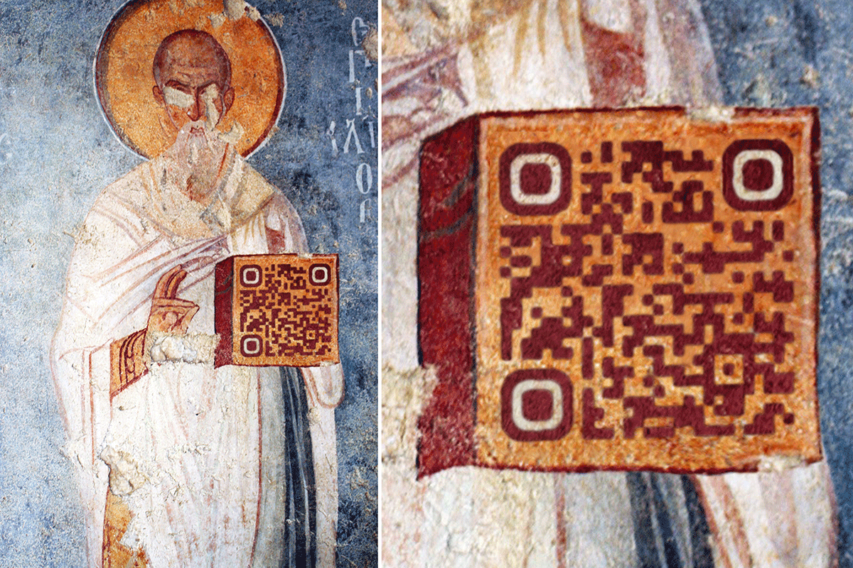
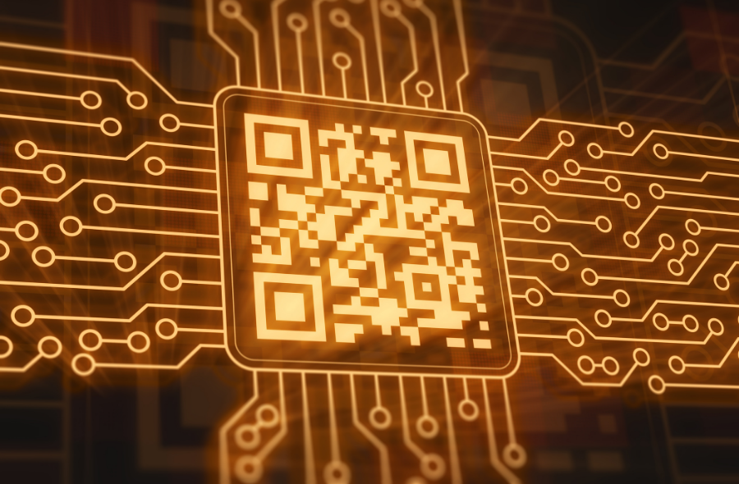
History With ICD
ICD National Office used QR Codes back in 2010
Had to have a QR Reader app on your phone
In 2017 Apple Phone camera became a reader
Today used in ICD marketing materials (show our postcard etc.)

Slide 7
Where Do We See QR Codes Today?
Currency
School Enrollment
QR Code Payment
Website Login
Mobile Tickets
Electronic Authorization
Restaurant Ordering – no need to print menus
Animal Tags

Slide 8
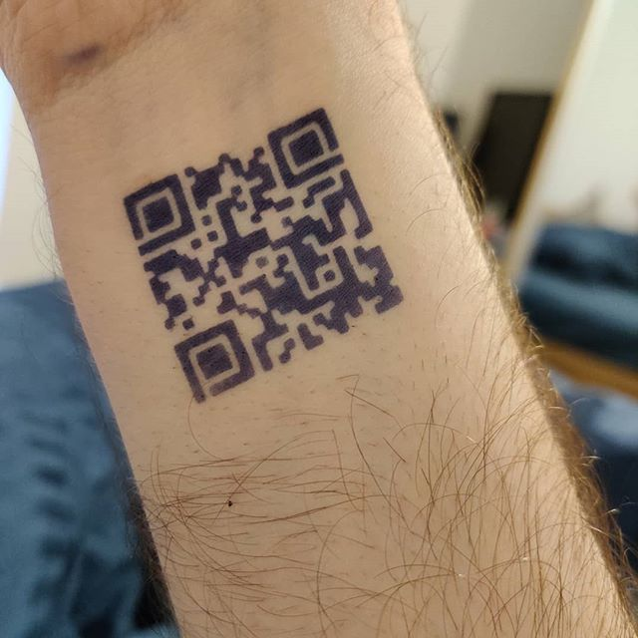
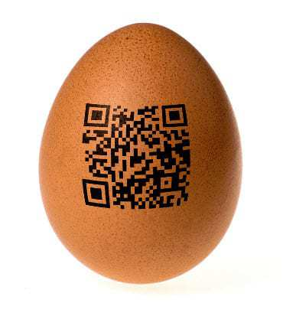
The Craziest Places
Gravestones and tattoos
Scratch off lottery tickets
Virtual grocery store
Airport Bathrooms
Giant QR Codes on top of roofs for advertisement
Haircuts
Food
Virtual Store

Slide 9
Why Are QR Codes Useful?
Limited Space
Cost effective
Accessible QR Reader
Contactless way of payment or registering
You can track the usage- (usually when you subscribe)
It isn’t going anywhere anytime soon.

Slide 10
ICD Centers Using QR Codes
Notes:
You can use this slide as your opening or closing slide. Should you choose to use it as a closing, make sure you review the main points of your presentation. One creative way to do that is by adding animations to the various graphics on a slide. This slide has 4 different graphics, and, when you view the slideshow, you will see that you can click to reveal the next graphic. Similarly, as you review the main topics in your presentation, you may want each point to show up when you are addressing that topic.
Add animation to images and graphics:
Select your image or graphic.
Click on the Animations tab.
Choose from the options. The animation for this slide is “Split”. The drop-down menu in the Animation section gives even more animations you can use.
If you have multiple graphics or images, you will see a number appear next to it that notes the order of the animations.
Note: You will want to choose the animations carefully. You do not want to make your audience dizzy from your presentation.

Slide 11
Other Examples
Brochure
WI-FI
Video for class
Promotional Video for a class or center
Link to website
Information for events
Flyers for events, fundraisers, and classes
Social Media Accounts

Slide 12
Taking QR Codes to the Next Level
Tino Application and Rules
Surveys
3D Printing
Enrollment for Classes
Added information for classes
Success story at your specific center (pdf or video)
Introducing the coordinator, LJC, or learning center
Showcase a popular or new vendor

Slide 13
QR Code Generators
Notes:
You can use this slide as your opening or closing slide. Should you choose to use it as a closing, make sure you review the main points of your presentation. One creative way to do that is by adding animations to the various graphics on a slide. This slide has 4 different graphics, and, when you view the slideshow, you will see that you can click to reveal the next graphic. Similarly, as you review the main topics in your presentation, you may want each point to show up when you are addressing that topic.
Add animation to images and graphics:
Select your image or graphic.
Click on the Animations tab.
Choose from the options. The animation for this slide is “Split”. The drop-down menu in the Animation section gives even more animations you can use.
If you have multiple graphics or images, you will see a number appear next to it that notes the order of the animations.
Note: You will want to choose the animations carefully. You do not want to make your audience dizzy from your presentation.

Slide 14
How Many Exist?
60,400,000 results
Make sure to open codes that come from a trusted source
Create codes on a safe generator to protect you and the participants

Slide 15
How Easy Is It?
Instagram will create one for you
Most generators are easy to use even without a subscription
Most QR Readers are already embedded into your mobile device
As long as the uploaded URL is active the QR code will never expire

Slide 16
Which QR Code Generators Are Best?
QRCode Monkey (Free)
QR Code Generator-Free (Free)
VistaPrint (Free)
Scanova (Free Trial)
Beaconstac (Free Trial)

Slide 17
Let’s Put It To The Test!
QR Code Monkey

