Slide 1
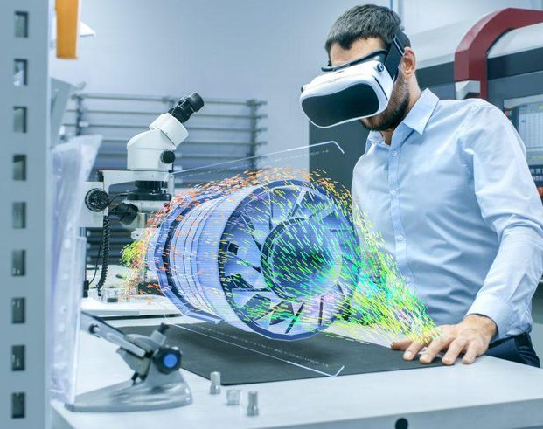
TU-SME

Slide 2
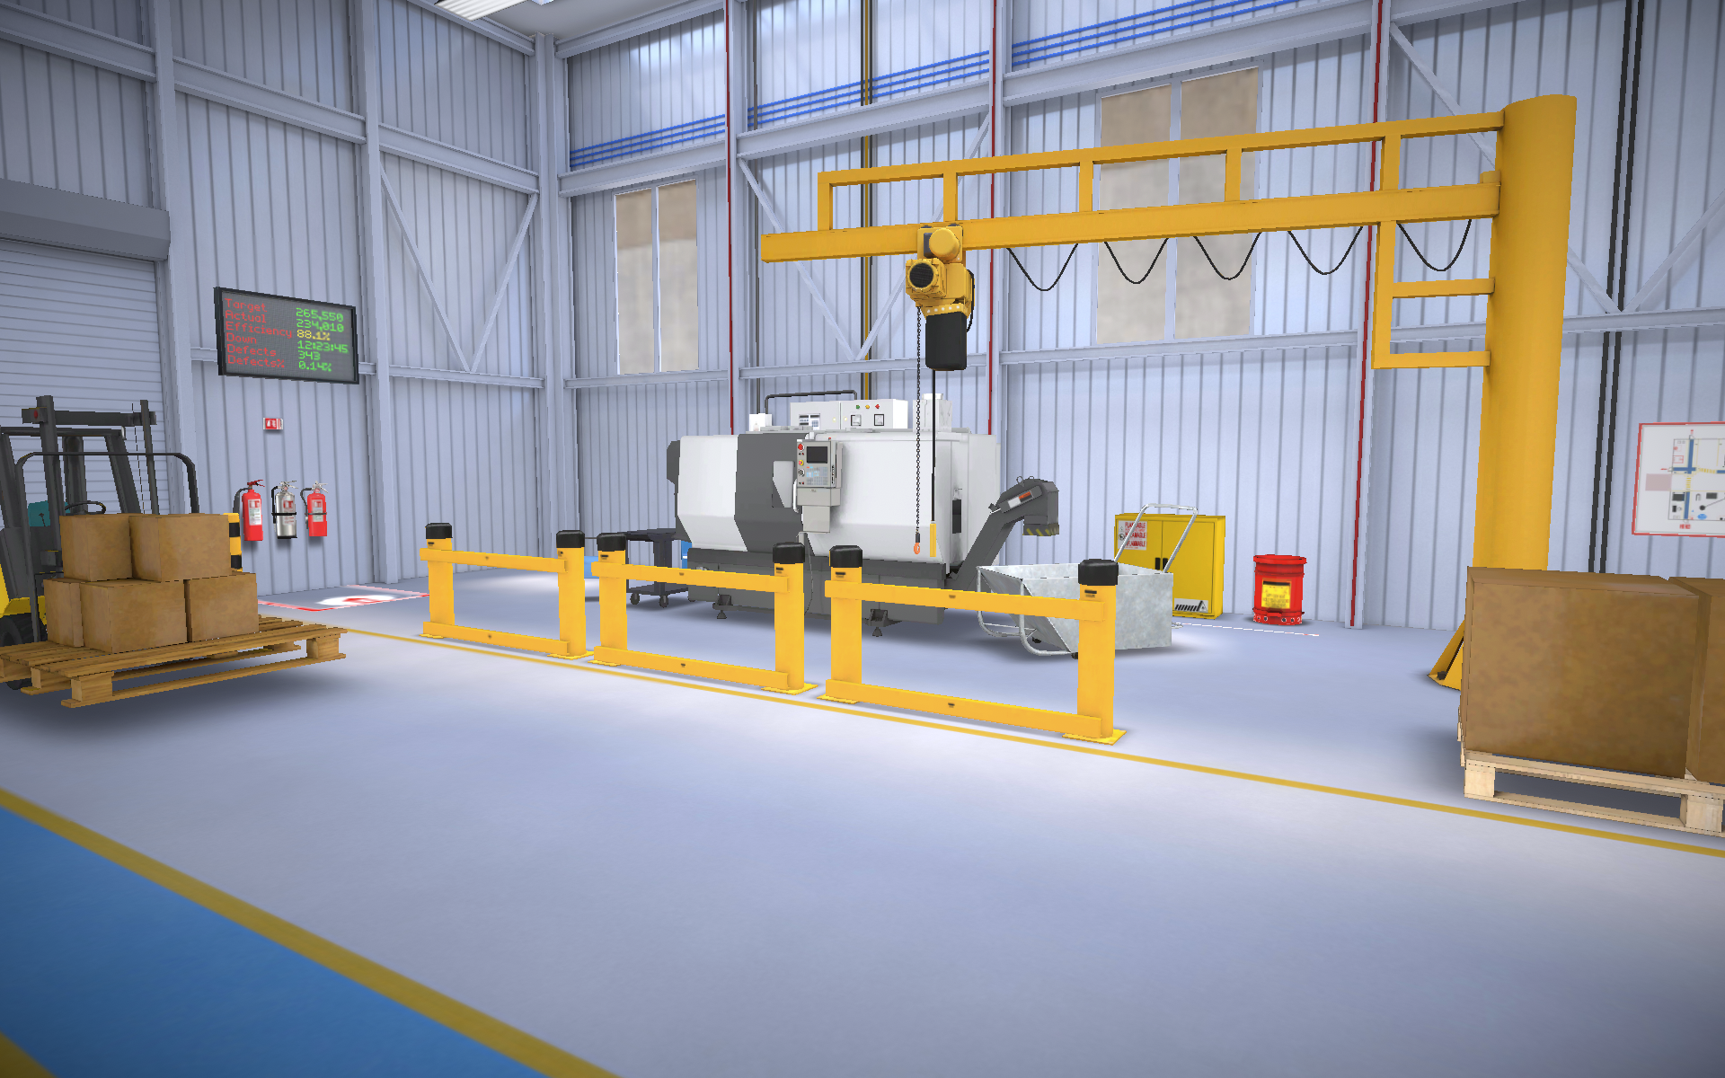
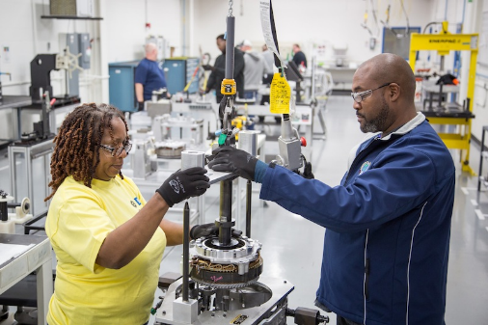
Optimizing Learning thru Leveraging Technology
Knowledge
(eLearning, ILT, etc.)
Applied Learning
(Extended Reality)
Hands on Skills
(OJT/Performance)
eLearning
  Introduction to Metals (Materials)
  Classification of Steel (Materials)
  Units of Measurement (math)
  Blueprint Reading (Inspection)
  Basic Measurement (Inspection)
  Math Fundamentals (Math)

Slide 3

Virtual Reality

Slide 4
VR Labs
Topic | Focus
Fire safety and extinguisher use | Safety
Identify safety hazards in a work environment | Safety
Hand Tool -5 S | Quality/Lean
Lifting and rigging safety- Identification &Inspection | Safety
Basic Part Inspection I (Inspecting Ods) | Inspection
Basic Part Inspection II (Inspecting Depths) | Inspection
Lifting and Rigging Safety-Lifting &Moving | Safety
Inspection III (Inspecting Width OD Groove) | Inspection
Inspection IV (Inspecting Threads) | Inspection
Hand and Power Tool Safety | Safety
Electrical Safety/ Lockout Tagout | Safety
Inspection V (Inspecting IDs)- Inner Diameter | Inspection
Inspection VI (Inspecting Parallelism) | Inspection
Inspection VII (Inspecting Position) | Inspection
Inspections VIII (Establishing Datums) | Inspection
CNC Workstation Set Up Lathe | Machining
CNC Workstation Set Up Mill | Machining
Welding | Welding
Welding | Welding
Additive Manufacturing | AM
Additive Manufacturing | AM
Additive Manufacturing | AM
Arc Flash | Safety
Cell Design Single piece flow | Quality/Lean

